Slide 1

Unreal Engine 4, Rendering and Mobile Platforms
Rolando Caloca Olivares Sr. Engine Programmer, Epic Games

Slide 2
What is this talk about?
Games & Engines
Unreal Engine 4 Architecture
UE4 Rendering on Mobile Platforms
Bonus: How to break into the games industry!

Slide 3
Bio
12 years in the game industry, 1 ½ years at Epic
5 years doing sports (NHL & MLB 2K) games
Shipped 5 titles on Xbox, PS2, Xbox 360 & PS3, helped on 4 others
5 years doing motion control games
Shipped 3 titles on PS3
Epic
Sr. Engine Programmer on Rendering Team
Helped optimized Elemental for PS4 Launch
Ported Renderer to mobile
Cross-compiler for shader languages
Parallel rendering
Etc!

Slide 4
Games
Some types of games

Slide 5
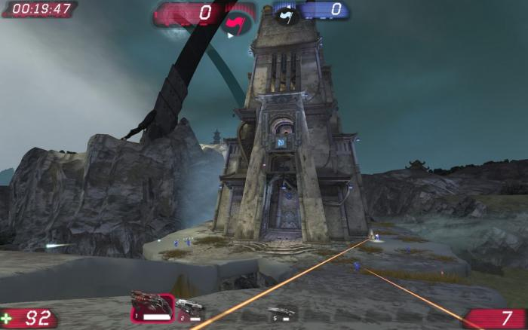
Games
Some types of games
Unreal Tournament

Slide 6
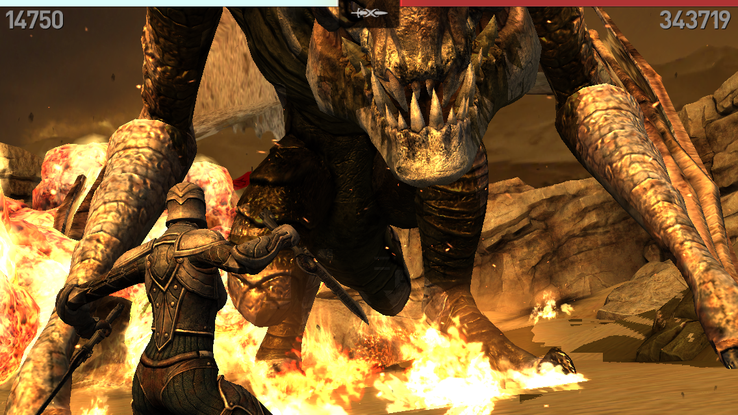
Games
Some types of games
Unreal Tournament
Infinity Blade 3

Slide 7
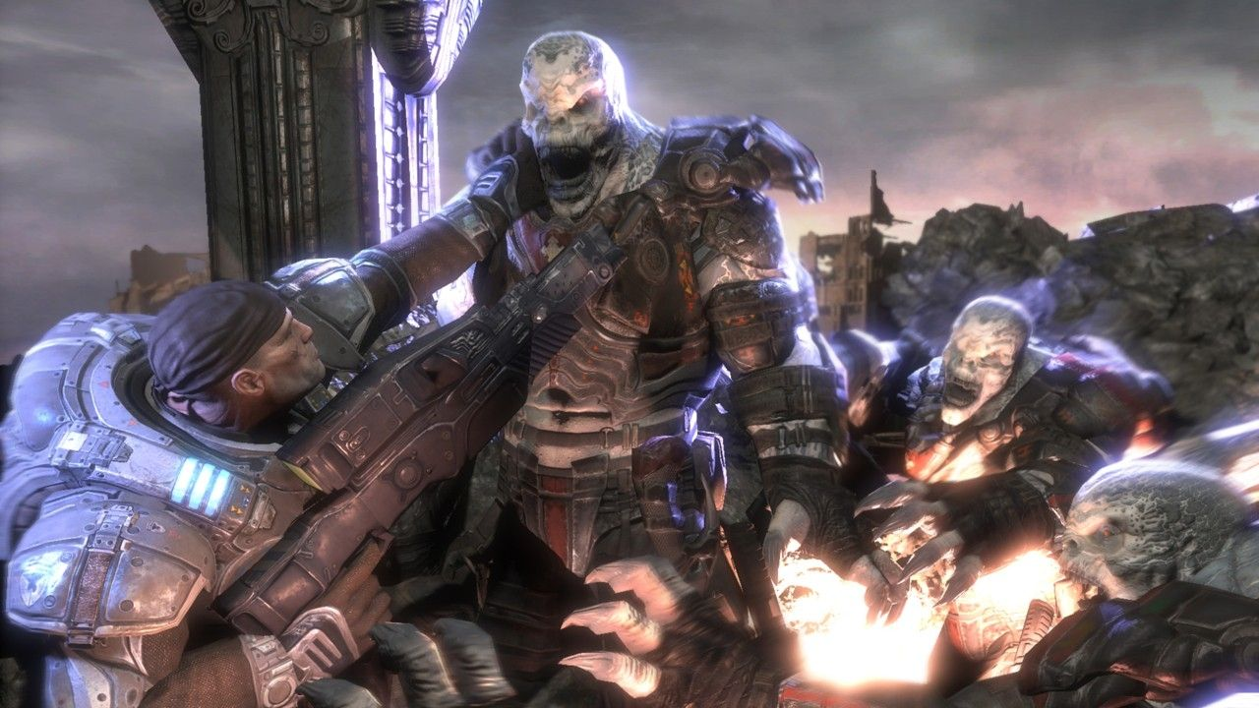
Games
Some types of games
Unreal Tournament
Infinity Blade 3
Gears of War 3

Slide 8
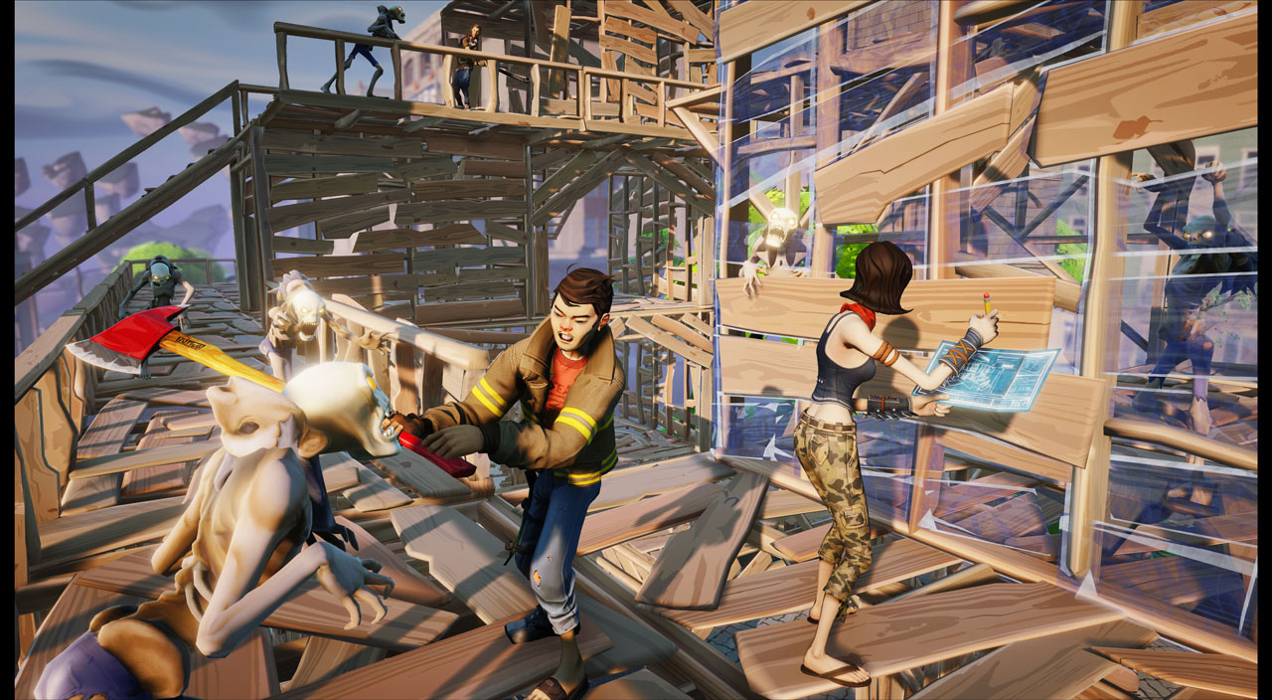
Games
Some types of games
Unreal Tournament
Infinity Blade 3
Gears of War 3
Fortnite

Slide 9

Games
Some types of games
Unreal Tournament
Infinity Blade 3
Gears of War 3
Fortnite
Tappy Chicken

Slide 10
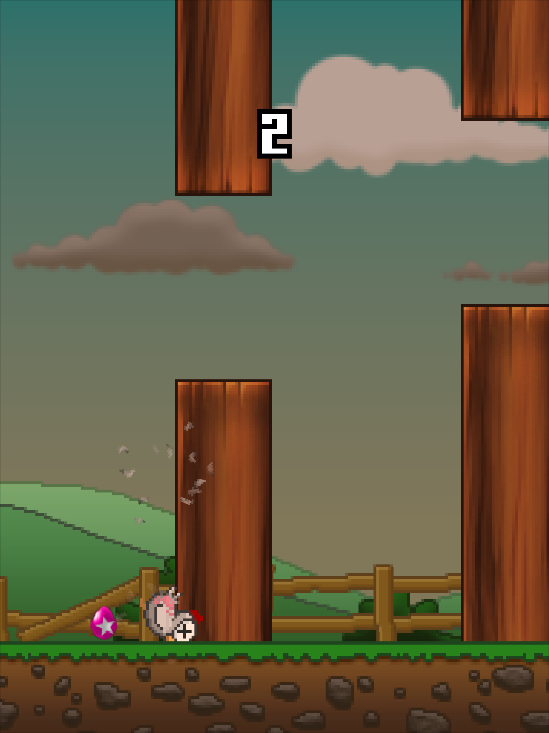
Games
Some types of games
Unreal Tournament
Infinity Blade 3
Gears of War 3
Fortnite
Tappy Chicken

Slide 11

A long time ago...
Games were simple!
100’s of lines of asm
Game logic
UpdatePaddleA()
UpdatePaddleB()
UpdateBall()
UpdateScoreIfNeeded()
Draw()

Slide 12
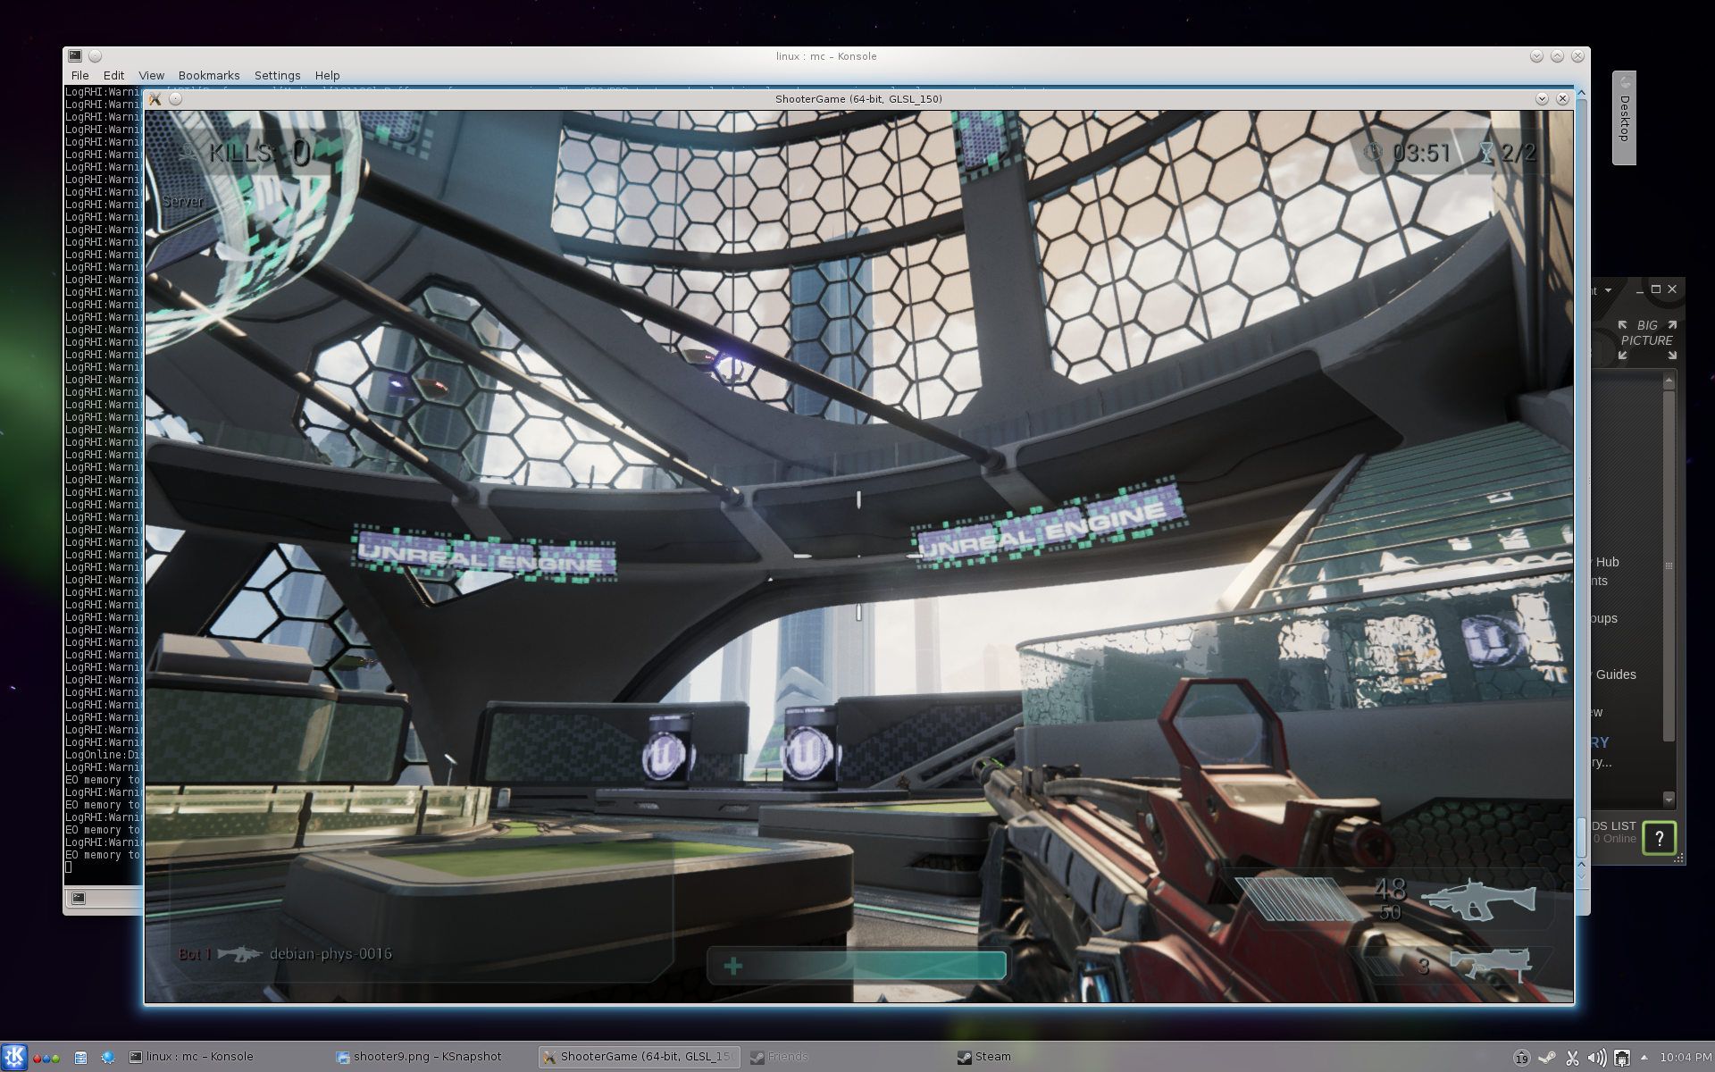
More recently…
Complexity!

Slide 13
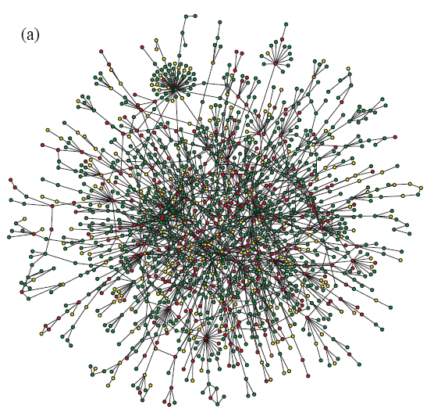
More recently…
Complexity!
Millions of lines of code!
Writing a game from scratch is possible but hard!
Game logic: Script Based

Slide 14
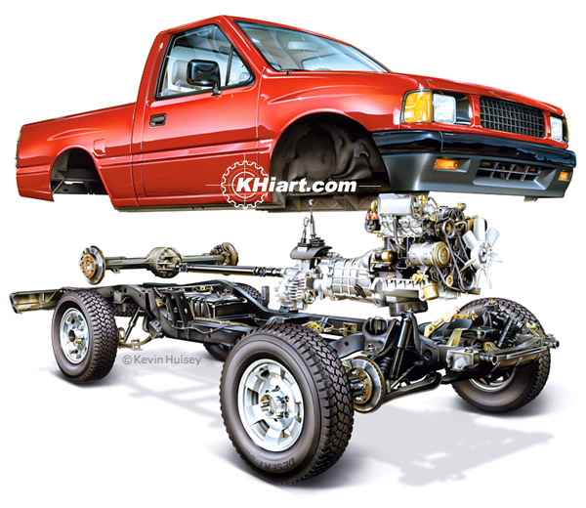
Engine
What is an Engine?

Slide 15

Engine
What is an Engine?
Save some time and run full speed!

Slide 16

Engine
What is an Engine?
Save some time and run full speed!
You can also write your own…

Slide 17

Engine
What is an Engine?
Save some time and run full speed!
You can also write your own…
Worth going through the exercise, but focus on a specific area

Slide 18
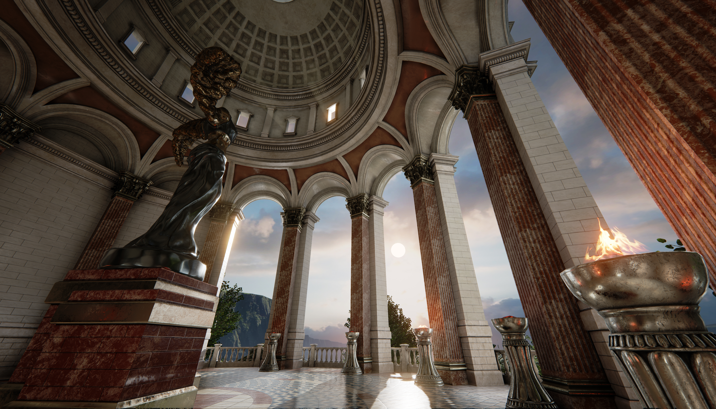
Unreal Engine 4

Slide 19
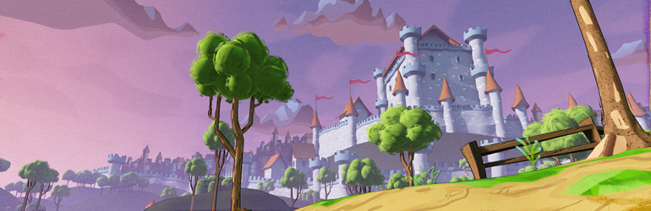
Unreal Engine 4

Slide 20
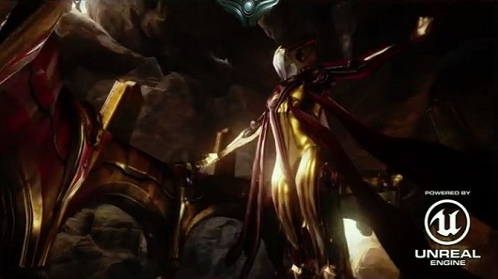
Unreal Engine 4

Slide 21

Unreal Engine 4

Slide 22

Unreal Engine 4

Slide 23
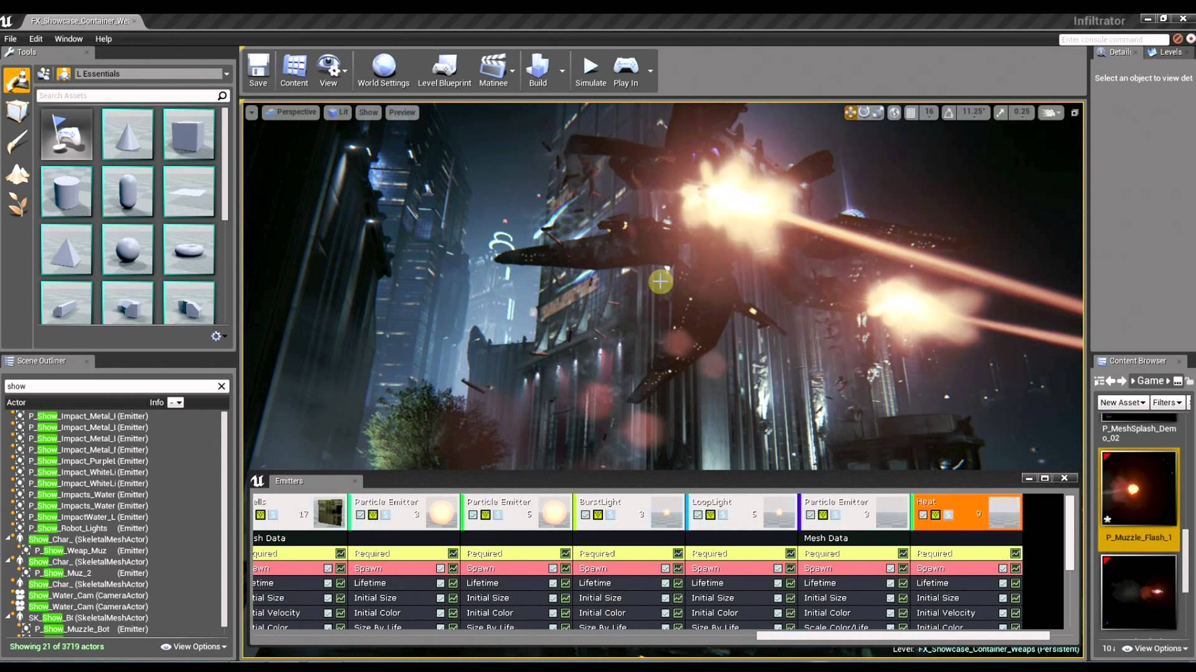
Unreal Engine 4
How we modify particle systems for the Infiltrator Demo

Slide 24
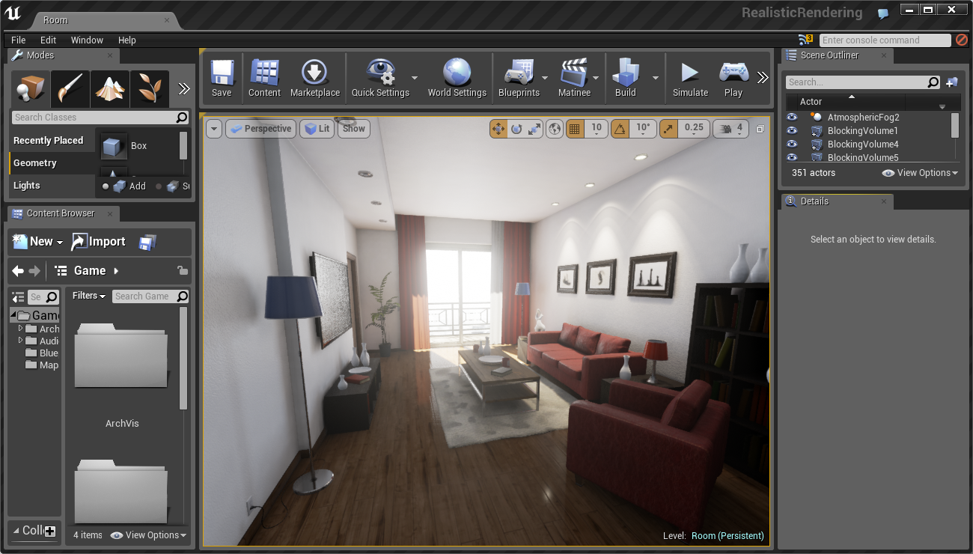
UE4: Not just games
You can also use it to model architectural design & preview in real-time

Slide 25
UE4 Architecture
Core
Framework
Blueprints
Gameplay
Art/Level Design
Platforms
Rendering

Slide 26
UE4 Blueprints
We decided to go with Blueprints to allow non-programmers write their own game logic
Programmers now expose gameplay and Engine to Blueprints
Finally nothing stops you from writing some or all of the gameplay code using C++!

Slide 27
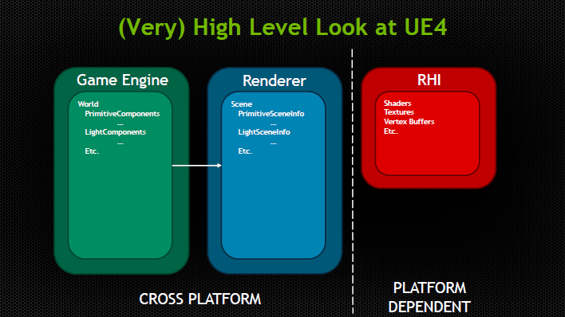
UE4 Rendering

Slide 28
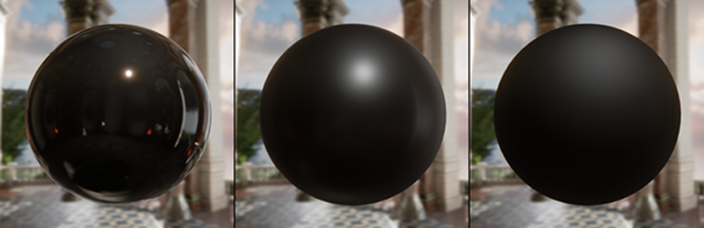
UE4 Rendering
Physically based renderer

Slide 29
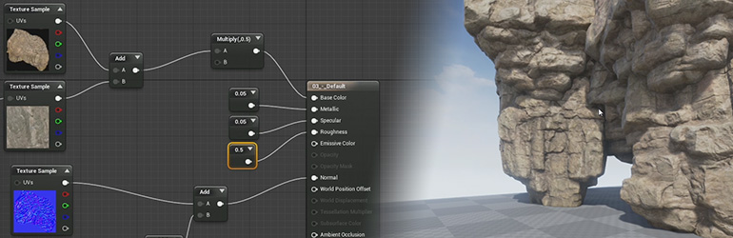
UE4 Renderer
Material Editor

Slide 30

UE4 Renderer
Fully scalable: From high-end desktop…

Slide 31
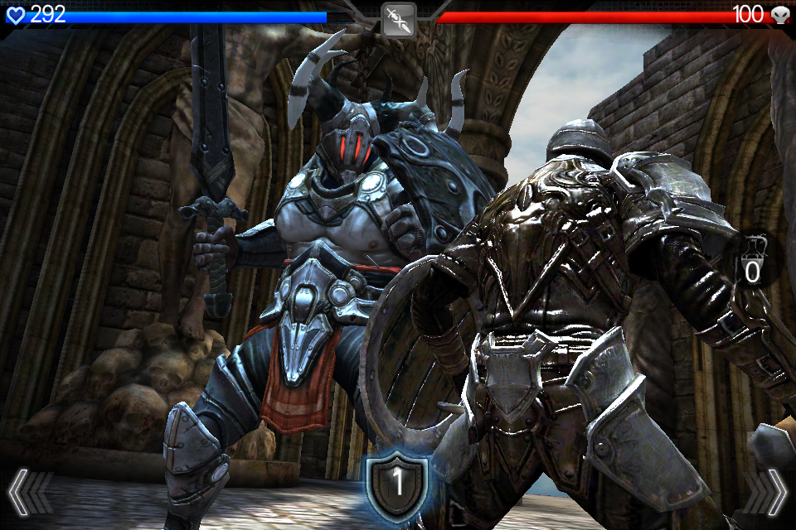
UE4 Renderer
Fully scalable: From high-end desktop…
All the way to mobile!

Slide 32
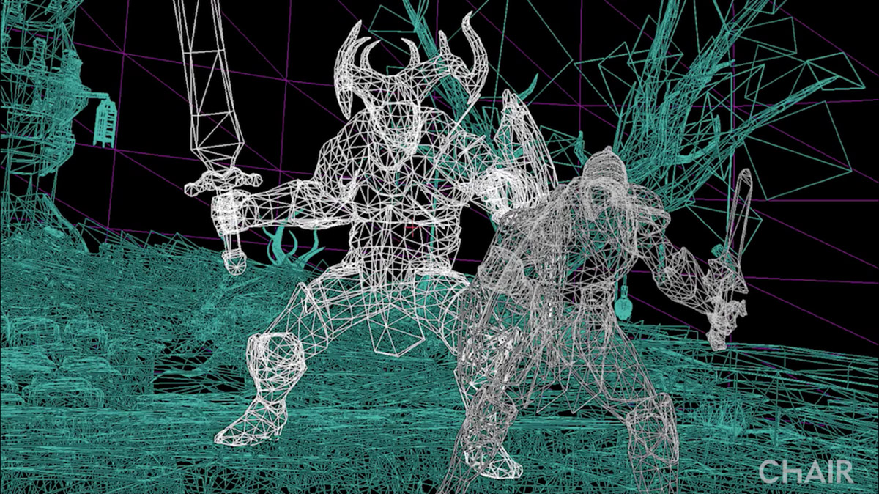
UE4 Renderer
Fully scalable: From high-end desktop…
All the way to mobile!
But developer has to know the right trade-offs!

Slide 33
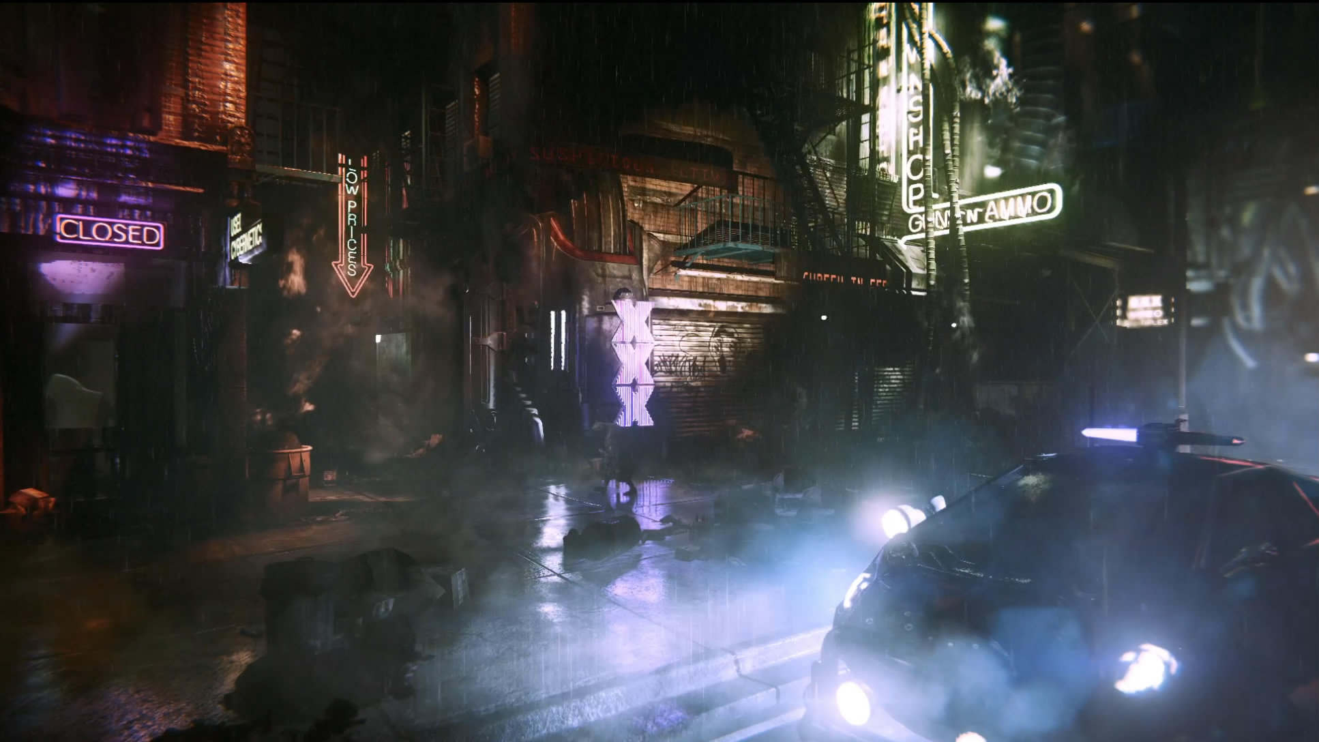
UE4 Renderer
Great, but what about mobile?

Slide 34
Mobile Platforms
Low power
Translates into:
Less processing power
Lower bandwidth
Thermal throttling
Different Inputs
Multi-touch
No hover!
Accelerometers, gyroscopes, etc.
No guaranteed memory!

Slide 35
UE4 Rendering
Forward vs Deferred
Lighting is *very* different!

Slide 36
UE4 Rendering
Forward vs Deferred
Lighting is *very* different!
Traditional (forward)
Per pixel, calculate lights & shading for final pixel information
Limited number of lights & light types

Slide 37
UE4 Rendering
Forward vs Deferred
Lighting is *very* different!
Traditional (forward)
Per pixel, calculate lights & shading for final pixel information
Limited number of lights & light types
Deferred
Per pixel, render geometry/material information
Later perform shading/lighting
Order of magnitude more lights/types!

Slide 38
UE4 Rendering
Forward vs Deferred
Lighting is *very* different!
Traditional (forward)
Per pixel, calculate lights & shading for final pixel information
Limited number of lights & light types
Deferred
Per pixel, render geometry/material information
Later perform shading/lighting
Order of magnitude more lights/types!
Currently mobile does forward
HW is getting fast enough for deferred!

Slide 39
UE4 Rendering
Post-processing
This gives it the ‘next-gen’/filmic look
Effects like grain, vignette, color correction, DOF, bloom, tonemap, etc.
Desktop allows dozens of effects
Mobile only allows a very small amount (currently!)
Each hardware generation getting better/faster!
We combine some passes for a custom optimized effect

Slide 40
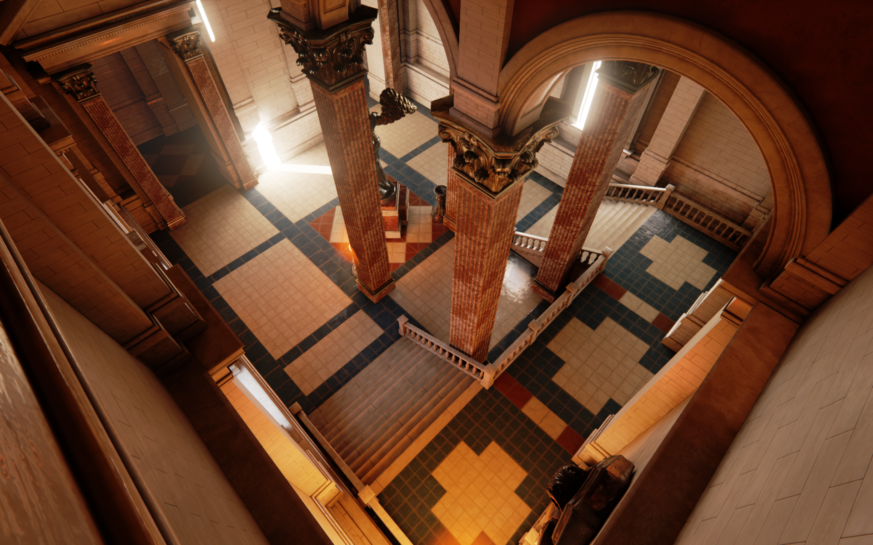
Comparison: PC

Slide 41
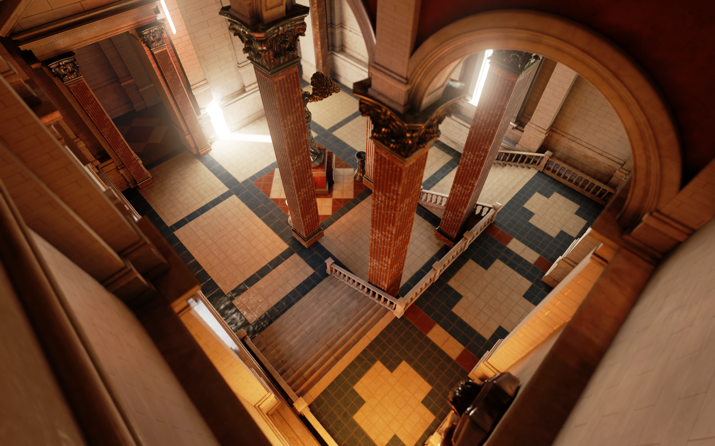
Comparison: Mobile

Slide 42
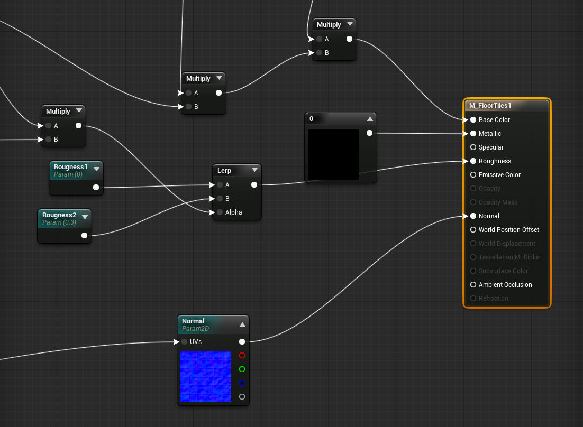
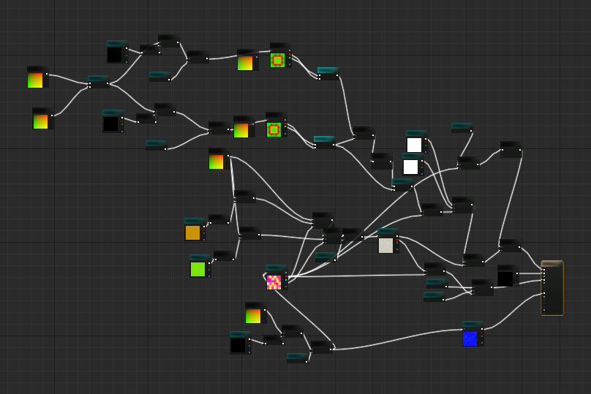
UE4 Rendering
Material Editor
Same for all platforms
Spent man-years on this!
Artists author using Feature Level nodes to target groups of hardware targets

Slide 43
UE4 Mobile Renderer
Feature Level Overview
iPhone4 = no lighting, but full access to material editor
iPhone4S+ = static lighting
iPhone5S+ = stationary sun w/ distance field shadows
Desktop = full deferred shading, support for static + dynamic lighting
Materials and lighting as consistent as possible between desktop and mobile!

Slide 44
UE4 Mobile: iOS
Lead development target as it’s more stable
Single known GPU feature set using OpenGL ES
Only use Objective C++ to talk to the OS
But as it’s a superset of C++, we compile the whole engine as OC++
Can develop an iOS game from a Mac or a PC
However: We can’t compile Obj C++ on PC, so we can do content-only games (currently!)

Slide 45
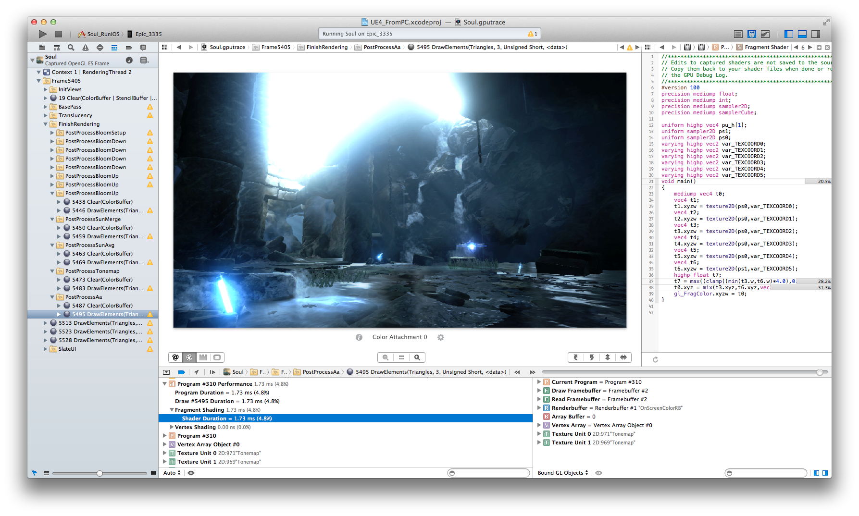
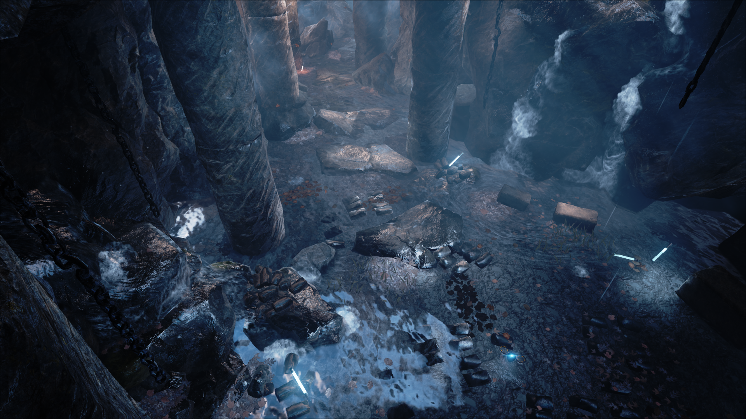
UE4 Mobile: iOS
Xcode

Slide 46
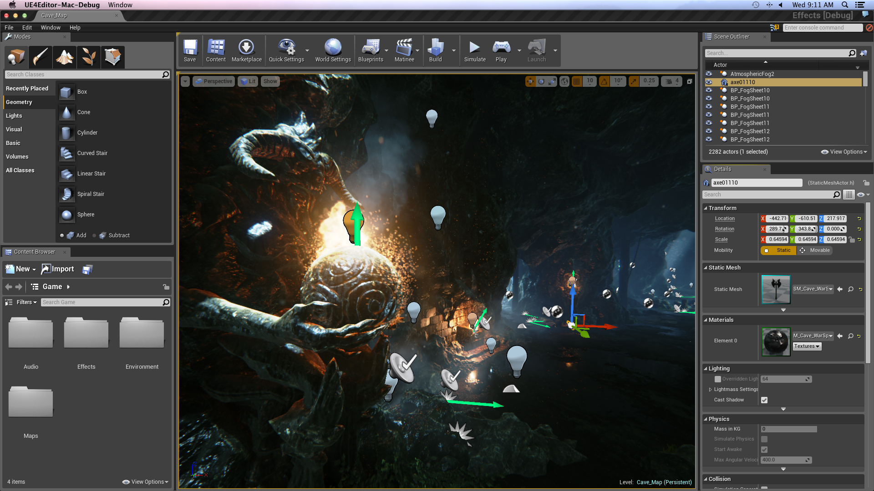
UE4 Mobile: Mac
First-class citizen!

Slide 47
UE4 Mobile: Android
A lot of models, similar to a PC
Even different flavors of Android!
Mainly 4 GPUs
Qualcomm, Tegra, Mali, PowerVR
Thin Java layer to the OS, rest is compiled native C++
Mostly similar to iOS, hard part is figuring out if a particular model has a specific feature set and will run at 30 or 60 fps

Slide 48
UE4 Mobile: HTML5
Craziest platform
UE4 on your browser
C++ code is converted to JavaScript (using Emscripten)
Which is then run using the asm.js extension
Runs at 50% native speed
Render using WebGL
Which uses the browser and might end up using D3D under the hood
So our shaders go from hlsl to glsl back to hlsl

Slide 49
UE4 Mobile: Windows Phone 8
Working on it!

Slide 50

Case Study: Tappy Chicken!
Created entirely using Blueprints

Slide 51

Case Study: Tappy Chicken!
Created entirely using Blueprints
One of our Tech Artists (no formal programming experience) wrote most of it in an afternoon

Slide 52
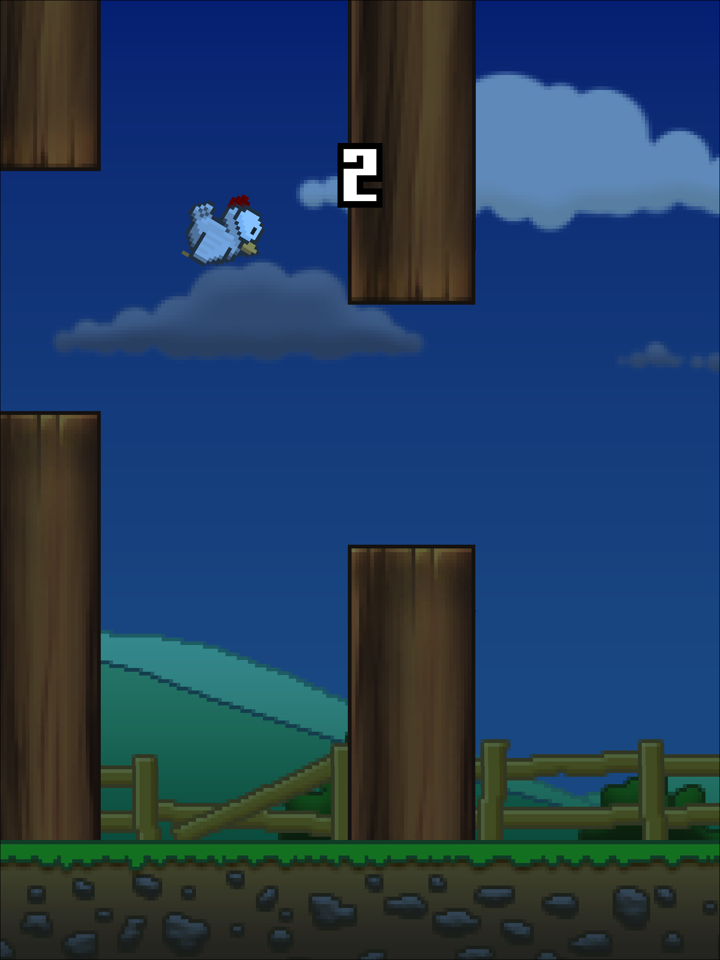
Case Study: Tappy Chicken!
Created entirely using Blueprints
One of our Tech Artists (no formal programming experience) wrote most of it in an afternoon
Procedurally generated levels
Available on ALL platforms

Slide 53
Bonus!
How to break into the industry!

Slide 54
Bonus!
How to break into the industry!
Areas:
Programming
Strong logic/math
Physics maybe
C++ preferable
Asm never hurts!
Write a plugin!

Slide 55
Bonus!
How to break into the industry!
Areas:
Programming
Design
Ability to write docs
Be able to communicate with programmers/artists!
Use Blueprints to prototype a game mechanic!

Slide 56
Bonus!
How to break into the industry!
Areas:
Programming
Design
Art
Animators, Texture, Modelers, Level Designers, Character Artists, Storyboard, Cinematics, VFX
Maya/3ds Max, Maru, Photoshop, Illustrator, etc.
Demo reel

Slide 57
Bonus!
How to break into the industry!
Areas:
Programming
Design
Art
Producers

Slide 58
Bonus!
How to break into the industry!
Areas:
Programming
Design
Art
Producers
QA, Tech writer, UX/UI, Cognitive Psychology, screenwriter, etc.!

Slide 59
Bonus!
How to break into the industry!
Areas:
Programming
Design
Art
Producers
QA, Tech writer, UX/UI, Cognitive Psychology, screenwriter, etc.!
"Yet, it sometimes seems that intense desire creates not only its own opportunities, but its own talents as well." – Bruce Lee, Tao of Jeet Kune Do

Slide 60
But wait! There’s more!
Don’t miss the Unreal Engine 4 subscription, talk with Joe Kreiner
Full source code
You can contribute code!

Slide 61
But wait! There’s more!
Don’t miss the Unreal Engine 4 subscription, talk with Joe Kreiner
Visit us in the booth!
Or at unrealengine.com
Youtube.com/unrealengine
Twitter: @unrealengine
@rcalocao
rcaloca.blogspot.com

Slide 62
References
ECGC 2014: The Cross-Platform New World: A Tour of Unreal Engine 4, Josh Adams
GDC 2014: Next Generation Mobile Rendering, Timothy Lottes & Niklas Smedberg
GDC 2014: Bringing Unreal Engine 4 to OpenGL: Enabling High-End Visuals from PC to Mobile, Evan Hart, Mathias Schott, Nick Penwarden
SIGGRAPH 2013: Real Shading in Unreal Engine 4, Brian Karis
Pic credits:
http://insertcredit.com/wp-content/uploads/2012/11/pong.jpeg
https://wiki.engr.illinois.edu/download/attachments/169574407/bo.png
http://www.car-illustration.com/illustrations/pickup-truck-illustration.jpg
http://www.automopedia.org/wp-content/uploads/2008/11/tubcar-russia.jpg
http://i.dailymail.co.uk/i/pix/2013/02/18/article-2280435-17A65C22000005DC-200_634x402.jpg

Slide 63
Done!
Questions?

